Slide 1
A survey for action recognition
Yujie Wang

Slide 2
Contents
Introduction
Databases
Review of papers
Frontiers of action recognition

Slide 3
action recognition data (file://5FTGDB2/action%20recognition%20data)
pose and action papers (file://5FTGDB2/pose%20and%20action)

Slide 4
Introduction

Slide 5
Introduction
Recognition
What
Actions may located in different semantic hierarchy. i.e. the semantics may overlap among actions. Maybe multiple labels.
Where
Spatial and Temporal [optional]
Application
Human-computer interaction
Contented-based video indexing
Intelligent surveillance
Dynamic scene understanding

Slide 6
Introduction
Task
Still images with person’s bounding box -> recognize the action
Videos that clipped well -> recognize the action
Videos that contain two person -> recognize the interaction between them.
Videos that not clipped well -> find the period of an action, bound the actor and denote its category [action detection]
Online stream -> predict the start frame and judge the action [online action detection]
……

Slide 7
Databases

Slide 8
Databases
Still image database
Monocular camera video database (2D)
3D/Kinect video database

Slide 9
Still image database

Slide 10
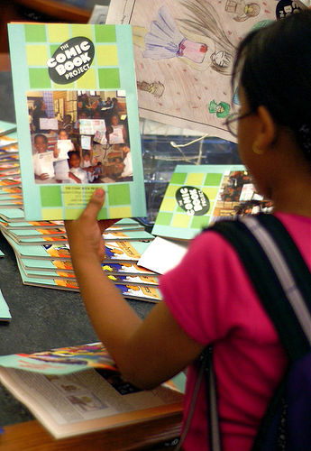
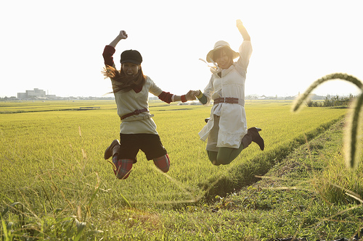
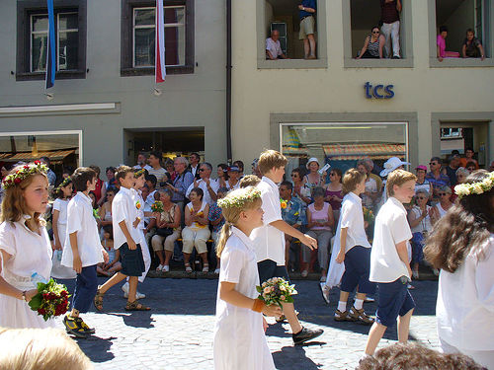
VOC 2012 action
Homepage： http://host.robots.ox.ac.uk/pascal/VOC/
One image may contains many people
Occlusion may appear among people
10 classes and other class
5804 images in total
Ground truth includes human’s bounding box and action label
Annotation rules: http://host.robots.ox.ac.uk/pascal/VOC/voc2012/action_guidelines/index.html
Phoning
Playing musical instrument
Reading book/magazine
Riding horse
Riding bike
Running
Taking photo
Walking
Using computer
Jumping
Other

Slide 11
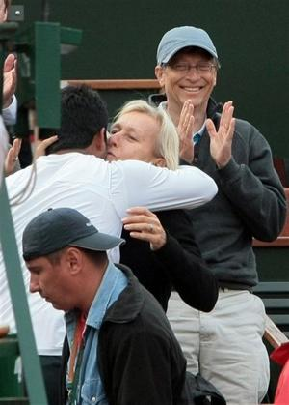
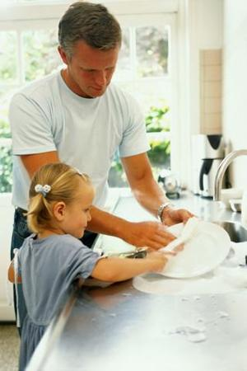
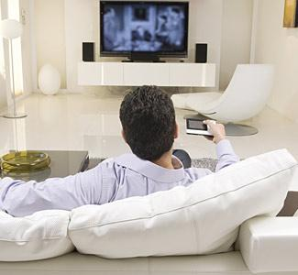
Stanford 40 action
applauding blowing bubbles
Brushing teeth cleaning the floor
climbing cooking
Cutting trees cutting vegetables
drinking feeding a horse
fishing fixing a bike
Fixing a car gardening
Holding an umbrella jumping
Looking through a microscope looking through a telescope
Playing guitar playing violin
Pouring liquid pushing a cart
reading phoning
Riding a bike riding a horse
Rowing a boat running
Shooting an arrow smoking
Taking photos texting message
Throwing frisby using a computer
Walking the dog washing dishes
Watching TV waving hands
Writing on a board writing on a book
Homepage：http://vision.stanford.edu/Datasets/40actions.html
One image may contains many people
Occlusion may appear among people
40 classes, 180-300 images per class
9532 images in total
Ground truth includes human’s bounding box and action label

Slide 12

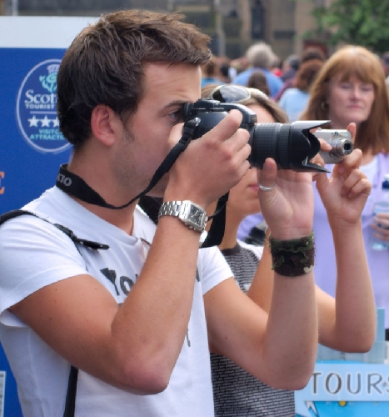
Willow 7 action
Homepage：http://www.di.ens.fr/willow/research/stillactions/
One image may contains many people
Occlusion may appear among people
7 classes
911 images in total
Ground truth includes human’s bounding box and action label
Interacting With Computer
Photographing
Playing music
Riding bike
Riding horse
Running
walking

Slide 13
Monocular camera video database

Slide 14
HMDB51
Homepage：http://serre-lab.clps.brown.edu/resource/hmdb-a-large-human-motion-database/
51 classes, 6766videos in total
One video may contain multiple person
Realistic videos, from movies and web videos and so on.
Clipped well
Ground truth includes action label, people’s bounding box and mask.
PROPERTY LABELS (ABBREVIATION)
visible body parts head(h), upper body(u),
full body (f), lower body(l)
camera motion motion (cm), static (nm)
camera viewpoint Front (fr), back (ba),
left(le), right(ri)
number of people Single (np1), two (np2),
three (np3)
video quality good (goo), medium (med),
ok (bad)

Slide 15
JHMDB
Brush hair Catch
Clap climb stairs
Golf Jump
Kick ball Pick
Pour Pull up
Push Run
Shoot ball Shoot bow
Shoot gun Sit
Stand Swing baseball
Throw Walk
wave
Homepage：http://jhmdb.is.tue.mpg.de/
Easy version(subset) of HMDB51
One video only contains one person
No occlusion
21 classes action, 40 videos per class
One kind of action is performed by different people
One clipped video lasts several seconds
Ground truth includes pose and action label

Slide 16
Keck dataset
turn left turn right
attention left attention right
Flap stop left
stop right stop both
attention both start
go back close distance
speed up come near
Homepage：http://www.umiacs.umd.edu/~zhuolin/Keckgesturedataset.html
One video contains one person
No occlusion and the full body is visible
Training set contains 3 people and each person performs 14 videos.
Test set contains 4 people and each person performs 14 videos.
The action is appeared in traffic guidance, like come near, speed up, stop left
Ground truth is the segment of frames for specific action.

Slide 17
MPII cooking dataset
Homepage：https://www.mpi-inf.mpg.de/departments/computer-vision-and-multimodal-computing/research/human-activity-recognition/mpii-cooking-activities-dataset/
One video contains one person
Fine-grained activity recognition
44 videos in total, all scenes are in kitchen
Each video is serval minutes
65 actions and a background class, many fine-grained action, like cut apart, cut slices, cut dice
The full body is not visible all the time
Ground truth includes the frame of specific action per video

Slide 18
Penn action
Homepage：http://dreamdragon.github.io/PennAction/
Multiple people in one video sometimes, but the main character are not occluded
2326 videos in total including 15 actions
Ground truth includes class label, coarse viewpoint(back or front), human body joints, 2D bounding boxes
Video is decompose to frames
Baseball pitch clean and jerk
pull ups strumming guitar
Baseball swing golf swing
Push ups tennis forehand
Bench press jumping jacks
Sit ups tennis serve
bowling jump rope
squats

Slide 19
UCF sports
Diving (14 videos)
Golf Swing (18 videos)
Kicking (20 videos)
Lifting (6 videos)
Riding Horse (12 videos)
Running (13 videos)
Skateboarding (12 videos)
Swing-Bench (20 videos)
Swing-Side (13 videos)
Walking (22 videos)
Homepage：http://crcv.ucf.edu/data/UCF_Sports_Action.php
One video contains one person
Sports video
Some action contains multiple viewpoint, not the same person’s multiple viewpoint.
Ground truth includes human bounding box per frame and action label

Slide 20
UCF 101
Homepage：http://crcv.ucf.edu/data/UCF101.php
Multiple people in one video sometimes, but the main character are not occluded
101 action classes and 100 and more videos per action class
Five main class:
Human-Object Interaction;
Body-Motion Only;
Human-Human Interaction;
Playing Musical Instruments;
Sports
Ground truth is video’s action label only

Slide 21
Kinect video database
http://research.microsoft.com/en-us/um/people/zliu/ActionRecoRsrc/default.htm
MSR Action 3D Dataset and other action 3D dataset
The provided visualization code can not work now

Slide 22
Review of papers

Slide 23
Challenges
Intra-class variation, including occlusion, motion and appearance
Subtle differences of fine-grained actions
Main methods
Pose-based method
Appearance-based method
Fusion
Think
How to represent a person and the action?
How to model spatial and temporal [optional] information?
How to reduce intra-variance?
……

Slide 24
Action recognition in still image

Slide 25
[2010] Action Recognition from a Distributed Representation of Pose and Appearance - UCB
Method
Poselets are used to represent pose and appearance (Different poselets have different activation in one image).
They proposed a method to filter discriminative poselets.
The method combines other person’s predicted action in the same image
Pros
Multiple poselets rather than holistic human image only -> ignore the relative position variation
Cons
Huge number of poselets detection models
Assume
Ground truth person bounding box is given or the person is the main content in image
Performance
VOC2010 action dataset 59.7% - classification accuracy

Slide 26
[2014] Action and Attributes from Wholes and Parts - UCB
This paper explores the part-based method is essential or obsolete
Method
Similar with the paper in previous slide. Main difference is using a deep version of poselets
Pros
Part-based feature improves performance, but when the network is better, the improvement from part is smaller
Cons
Huge number of poselets detection models
Method is by products, not the point of this paper
Assume
Ground truth person bounding box is given or the person is the main content in image
Performance
VOC 2012 action test set 82.6% mAP
Berkeley attributes of people dataset 89.5% mAP

Slide 27
[2014] R-CNNs for Pose Estimation and Action Detection - UCB
They use RCNN framework to detect human, estimate pose and classify action jointly
They introduce a new task: action detection
Method
Share conv feature, then append three classifiers.
How to represent action ?
Holistic human image
Pros
Jointly solve three tasks and results is better than train themselves separately
Cons
Without consider the task specific properties
Assume
One feature can represent multiple information.
Performance
VOC 2012 test set
Detection : 56.4 mAP
Pose : 15.5 mAP
Action detection : 21.6 mAP

Slide 28
[2015] Contextual Action Recognition with R*CNN - UCB
Method
Given ground truth person bounding box and proposals generated by SS, dynamically select the most discriminative part. Then combine person’s score and selected patch’s score.
Ground truth person bounding box is used to eliminate candidate proposals.
Pros
Combine holistic human image with context patches near the person.
Fully exploit the context(most discriminative part), attention mechanism
Assume
Ground truth person bounding box is given at test time
Performance
VOC 2012 action test set 90.2% mAP
Berkeley attributes of people test set 89.2% mAP
Stanford 40 action 90.9% mAP

Slide 29
Conclusion and Thinking
Most papers focus on appearance-based method in still image action recognition. Possible reasons: 1. pose estimation is not accurate enough 2. dataset’s label care about human-object interaction more.
Some papers that not mentioned are not work in a huge probability, like CVPR16 DeepCAMP. Why using AlexNet as base model? To avoid compare with the state-of-the-art method using VGG?
The context is important in VOC action dataset, because 7 in 10 classes are relative with human-object interaction.
The usage of context must be limited near the person, or the method may tend to overfit by focusing on the context.

Slide 30
Action recognition in videos

Slide 31
Pose-based Action recognition in video
Similarities and differences between still image and video
Video is composed of frames (still images)
Consecutive frames have large redundancies
Video provides temporal information besides spatial information
Spatial combining with temporal information can remedy confusion among confused action classes, like stand and walk.

Slide 32
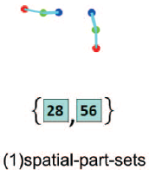
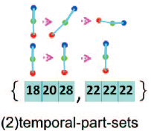
[2013] An Approach to Pose-Based Action Recognition
Method
Estimate best K pose for each frame
Select the best pose for each frame via maximizing the energy function
Based on 2D joints, split body skeleton into parts: head, l/r arms, l/r legs
For every part, learn a set of pose templates, the a part can be represented by a vector of template index. Discretization
Data mining techniques are used to find the pair set: co-occurring part template in spatial and co-occurring part template sequence in temporal.
At test time, using templates to represent the pose per frame, then statistic the pair that located in pair set both in spatial and temporal to compose histogram, finally classified by SVM.

Slide 33
[2013] An Approach to Pose-Based Action Recognition
Pros
Good Interpretability
Cons
Train and test in easy dataset, hard to judge the effectiveness
Assume
The video is clipped well, only recognition one person’s action and person’s pose can be estimated well
Performance
UCF sport dataset 90% accuracy
Keck gesture dataset 97.62% accuracy
MSR-Action3D 90.22% accuracy

Slide 34
[2015] P-CNN: Pose-based CNN Features for Action Recognition
Method
Decomposed body into l/r hands, upper body, full body and full image patches
Extract appearance(RGB image) and motion(optical flow image) features via CNN for each frame and each part as static descriptor. At the same time, calculate feature’s delta between frames as dynamic descriptor
Adopt max and min aggregation for each descriptor dimension over all video frames
After normalize, concatenate them as the video descriptor.
Pros
Robust: combine appearance and motion feature
Cons
Only captures motion information between two frames
Assume
The video is clipped well, only recognition one person’s action and person’s pose can be estimated well

Slide 35
[2015] P-CNN: Pose-based CNN Features for Action Recognition
Performance
JHMDB
74.6% mAP with ground truth pose
66.8% mAP without ground truth pose
Sub-JHMDB
72.5% mAP with ground truth pose
61.1% mAP without ground truth pose
MPII Cooking datasets
62.3% mAP without ground truth pose

Slide 36
[2015] Joint Action Recognition and Pose Estimation From Video
Method
Building And-Or graph to represent human’s action and pose jointly. The graph is a tree like structure from coarse to fine: action(video) -> multiple pose(frame) -> mid-level parts(like poselets) -> fine-level parts(joint patch).
Different score mechanisms are built for evaluate the sequence in different level.
Conditional probability is used to model the temporal variation of pose between consecutive frames in score mechanism.
In inference, first detect multiple mid-level parts for each type, and get fine-level parts from them via pose estimation(2D). Then select the best mid-level parts sequence, and make the action decision with highest score. Finally decide the pose by best mid-level parts.
Notes:
And nodes是指由空间上组成的关系。Or nodes是指该部分有多种可能的关系，比如poselets的正脸，侧脸都有一定的激活，但是究竟是哪种是不确定的

Slide 37
[2015] Joint Action Recognition and Pose Estimation From Video
Pros
Pose is refined by action (ST-parts selection process)
Mid-level parts are used to reduce variation
Cons
Too sophisticated ; the pose estimation method they use can’t handle the self-occlusion problem
Assume
The video is clipped well, only recognition one person’s action and person is the main content in video
Performance
Penn action dataset
Action classification 85.5% accuracy
Pose estimation 48% threshold 0.2
Sub-JHMDB
Action classification 61.2% accuracy
Pose estimation 55.7% threshold 0.2

Slide 38
[2015] Category-blind Human Action Recognition A Practical Recognition System
Don’t need to distinguish one person’s action or two persons’ interaction, solve these problems in a unified framework.
Method
Combination of motion units(MU), vectors generated by 3D body joints, are used to represent body in video. Frame(vector) -> Video(matrix)
Quantize MU into several common pattern - motion primitives(MP), like template, and use them to represent body in video
Conditional probability is used to constructed MP co-occurrence matrix for each action class, which implicitly utilize temporal information.
MP co-occurrence patterns are used to model potential action, and it can be represented as a weighted graph.
Finally, for each class, find the maximum clique of weighted graph to get the score.

Slide 39
[2015] Category-blind Human Action Recognition A Practical Recognition System
Pros
Unify one person’s action prediction and two persons’ interaction prediction
Cons
Maybe time consuming
Assume
The video only contains one person action or two-person intersection or co-exist.

Slide 40


[2016] Pose for Action – Action for Pose
Use pose to judge action, then use action prior to improve pose estimation
Method
Estimate pose by maximize
The first term use random regression forest with convolutional channel features to model, the second term use Gaussian mixture model to model
For each frame, estimate pose independently
Ntraj+ feature and method in Dense Trajectory are used to judge action.
With action specific probability, update pose estimation by
The first term calculated by partially conditional forests
Notes:
$$χ \text{is} \text{the} \text{set} \text{of} joints, x_{i} is joint vector represents 2D location of i th joint$$
$φ_{j}(x_{j}|I) \text{i}s$ likelihood of j th joint at location xj
$ψ_{jp}(x_{j},x_{p})$ is the deformation cost for joint-parent pair(j,p)

Slide 41
[2016] Pose for Action – Action for Pose
Pros
Action can be estimated during pose estimation without substantially increasing the computational time of pose estimation
Action provide strong regulation for pose estimation
Cons
Time consuming job, 10+ seconds
Performance
Sub-JHMDB
Pose estimation : 73.8% threshold 0.2
Action classification : 74.6% accuracy
Penn Action dataset
Pose estimation: 81.1% threshold 0.2
Action classification : 92.9% accuracy
Notes:
$$χ \text{is} \text{the} \text{set} \text{of} joints, x_{i} is joint vector represents 2D location of i th joint$$
$φ_{j}(x_{j}|I) \text{i}s$ likelihood of j th joint at location xj
$ψ_{jp}(x_{j},x_{p})$ is the deformation cost for joint-parent pair(j,p)

Slide 42
Conclusion and Thinking
To avoid big intra-class variation, some methods adopt part template or motion template, convert consecutive variable into discrete variable.
Combining pose and appearance have good performance
Jointly solving pose estimation and action classification benefit each other
Exploit temporal information:
Exploit relations between different parts’ sequential information and extract co-occurring pattern – ignore holistic temporal information
Instead of using temporal information directly, motion information is another choice – only capture serval frames‘ information
Construct conditional probability between frames– only capture consecutive frames‘ information

Slide 43
Frontiers of action recognition
Papers about action recognition in CVPR2016 and ECCV2016 including pose-based and appearance/motion based methods
Motion + RGB have better performance than pose-based method. Why?
1. Motion + RGB are CNN based method -> lots of tricks are used, and data is easy to get than pose.
2. pose suffer more variation than Motion + RGB

Slide 44
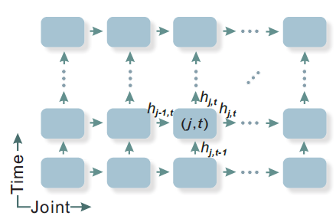
Spatio-Temporal LSTM with Trust Gates for 3D Human Action Recognition
3D skeleton data as input.
LSTM is used to model spatial relation among joints and temporal information among frames.
Extend LSTM from one dimension to two dimension. The x-dim and y-dim represent joints sequence and time sequence.
Human pose joints can be seen as tree structure. And it can be serialized via traversal. Then human pose is converted to sequence.
The input pose is not reliable sometimes due to noise and occlusion. Assume joints are relevant with adjacent joint and the state in last frame. So they add a trust gate in normal LSTM to help about deciding when and how to remember and forget the contents of the memory cell.
Average the predictions of every frame’s SOFTMAX classifier.

Slide 45
NTU RGB+D Dataset http://rose1.ntu.edu.sg/Datasets/actionRecognition.asp
Cross-object 69.2% (half train half test for same action)
Cross-view 77.7%
SBU Interaction Dataset http://www3.cs.stonybrook.edu/~kyun/research/kinect_interaction/
93.3%
UT-Kinect Dataset http://cvrc.ece.utexas.edu/KinectDatasets/HOJ3D.html
95%
Berkeley MHAD http://tele-immersion.citris-uc.org/berkeley_mhad/
100%
MSR Action3D
94.8%

Slide 46
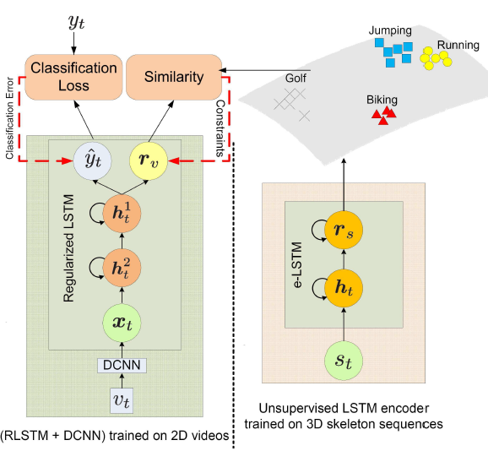
Regularizing Long Short Term Memory with 3D Human-Skeleton Sequences for Action Recognition
Assume the video and skeleton sequence are both about human motion and their feature representations should be similar.
In training phase, 3D Skeleton data is used to train an encoder in unsupervised manner. While during test time, no skeleton data is used
In training, extract features for every frame via CNN, and these features are fed into LSTM, the top LSTM output two branch, one is for classification, another is for comparing with the feature that generated by encoder. The distance of two features should be near.
Adopt the hybrid steepest descent. This method update parameters like BPTT when no constraint is violated, otherwise, only BP the sum of gradients of the violated constraints.
Performance
UCF101 86.9% accuracy
HMDB51 55.3% accuracy

Slide 47
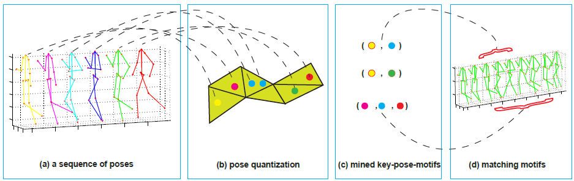
Mining 3D Key-Pose-Motifs for Action Recognition
Action classification -> pattern matching
Key-pose-motif is a subsequence pattern for a specific class, which is representative and discriminative.
Method
Quantize poses to a dictionary of discrete symbols. Then they adopt soft-quantize - use a probability vector, that the pose belongs to which symbol, to represent pose. Now the pose sequence can be represented as a matrix.
They proposed a method for mining key-pose-motifs from train matrices. And each motif has a score.
When testing, they match the test sequence to the key-pose-motifs of each class. And the final score is the average score of all motifs for specific class.

Slide 48
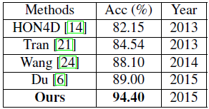
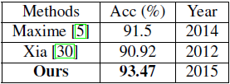
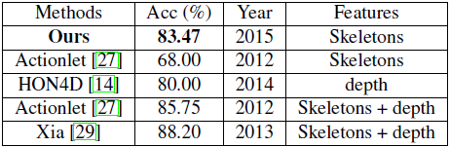
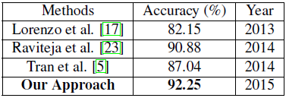
MSR-Action3D Dataset 94.4% accuracy
MSR Daily Activity3D 83.47% accuracy
UTKinect Dataset 93.47% accuracy
Florence dataset 92.25% accuracy

Slide 49
Action ~ Transformations
They Argue that:
current action recognition approaches tend to overfit by focusing on scene context and hence do not generalize well.
Action is determined by precondition and effect.
The input is two stream: RGB image and optical flow.
They set precondition’s length and effect’s length as latent variable, so they adopt EM like algorithm: 1. learning network’s parameter 2. estimate the best two length via brute force.

Slide 50
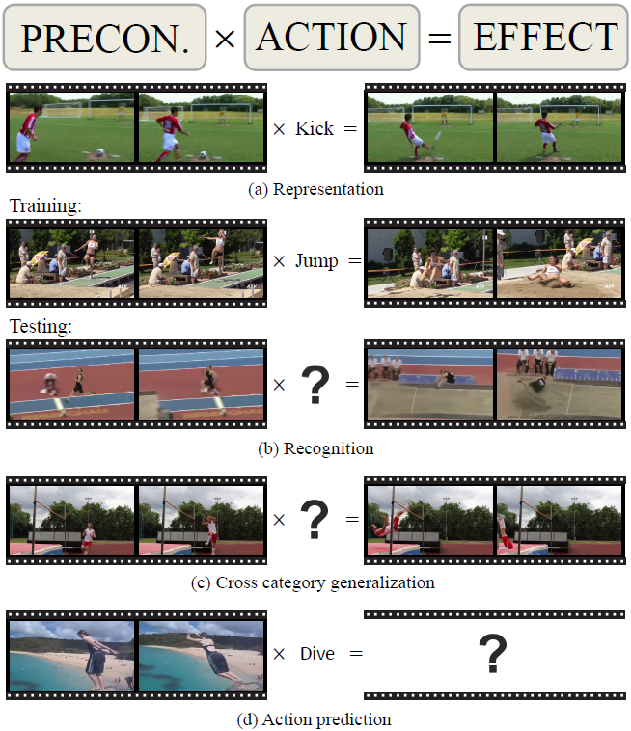

Slide 51
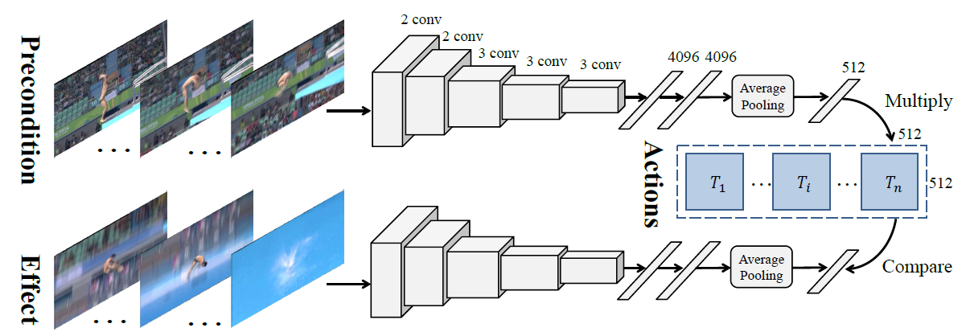
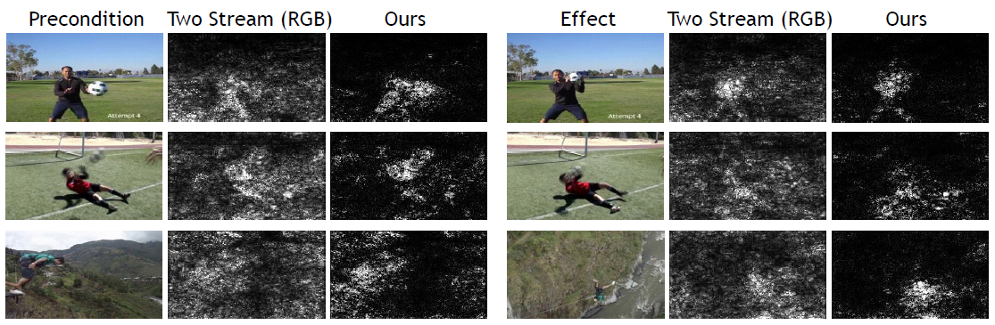

Slide 52
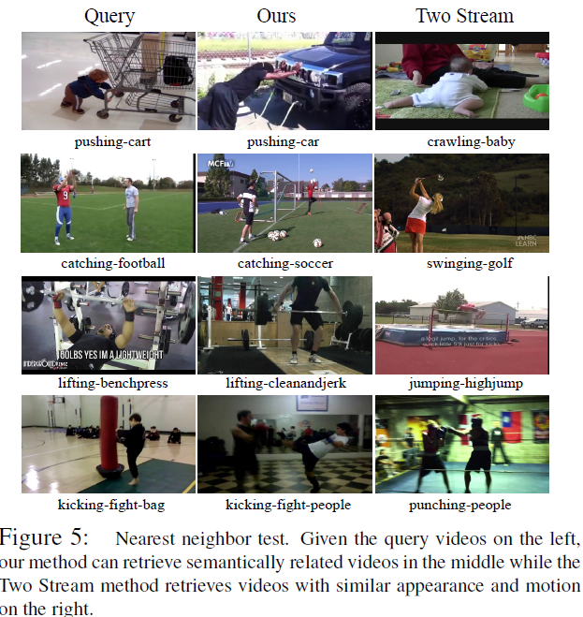

Slide 53
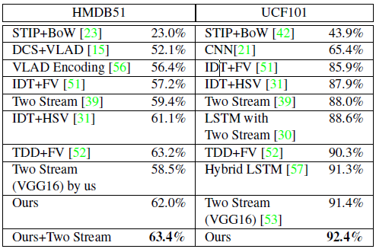
HMDB51
62% accuracy
UCF101
92.4% accuracy
ACT
Classification: 80.6% accuracy
Cross category generalization: 65.5% accuracy

Slide 54
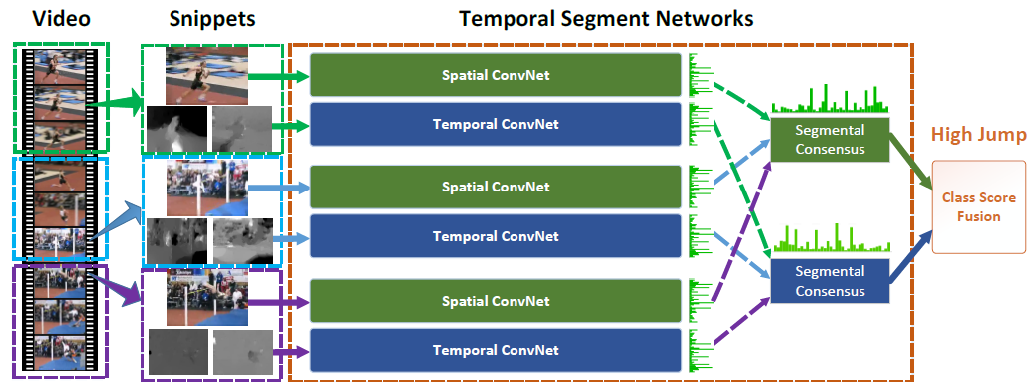
Temporal Segment Networks Towards Good practices for deep action recognition
Input: RGB image, + Stacked optical flow and warped optical flow (reduce camera motion’s effect)
Sample snippets from entire video. For each snippet, make separate decision and finally combine them

Slide 55
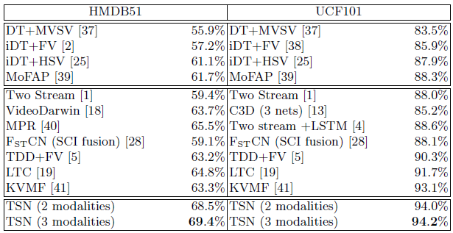
Temporal Segment Networks Towards Good practices for deep action recognition
UCF101
94.2% accuracy
HMDB51
69.4% accuracy

Slide 56
Conclusion and Thinking
Motion integrate temporal and spatial information implicitly.
LSTM and motion can both used to model temporal information. Maybe LSTM is better than motion in modeling long time sequence. Motion can only capture temporal and spatial information in consecutive frames. – like part and holistic. Can combine them?
LSTM is friendly with 3D skeleton data, while motion is not.
Pose and action are good regulation each other

Slide 57
Stacked motion
Convs
Feat_m
feat
softmax
action
image
Convs
Feat_I
T_jump, T_walk …
Selected by probability
Action specific pose space
T
pose
Some structure
Feat_P
1. Train black dot line parts
2. Train red dot line parts
3. Joint training
Risk of overfitting! Can we get enough data to train action specific pose transformation matrix?

Slide 58
Thanks

